Slide 1

Compiler for Chemistry Reaction Simulation
Supervisor Research Scholar
Dr. G.Michael S.V.N.Sreedevi
Professor 192311218
Computer Science and Engineering CSE
Saveetha School of Engineering Saveetha School of Engineering

Slide 2
AGENDA
INTRODUCTION
EXISTING MODELS
FLAWS IN EXISTING MODEL
PROPOSED MODEL
IMPLEMENTATION
RESULTS AND DISCUSSION
FUTURE ENHANCEMENTS
QUERIES

Slide 3
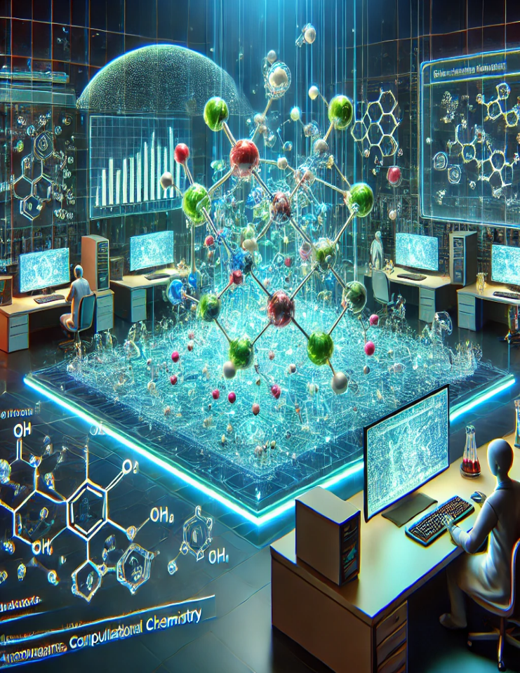
Introduction to Chemistry Reaction Simulation
What is reaction simulation?
Chemical reactions are governed by quantum mechanics
Simulations help predict reaction outcomes, energy changes, and mechanisms
Why is an efficient compiler needed?
Traditional methods are slow, computationally expensive, and error-prone

Slide 4
Importance of Chemistry Reaction Simulation
Applications of reaction simulation in various fields:
Drug Discovery: Predicting drug interactions and molecular stability.
Material Science: Designing new materials and optimizing catalysts.
Energy Research: Enhancing battery performance and fuel cell efficiency.
Environmental Science: Modeling atmospheric reactions and pollutant dispersion.

Slide 5
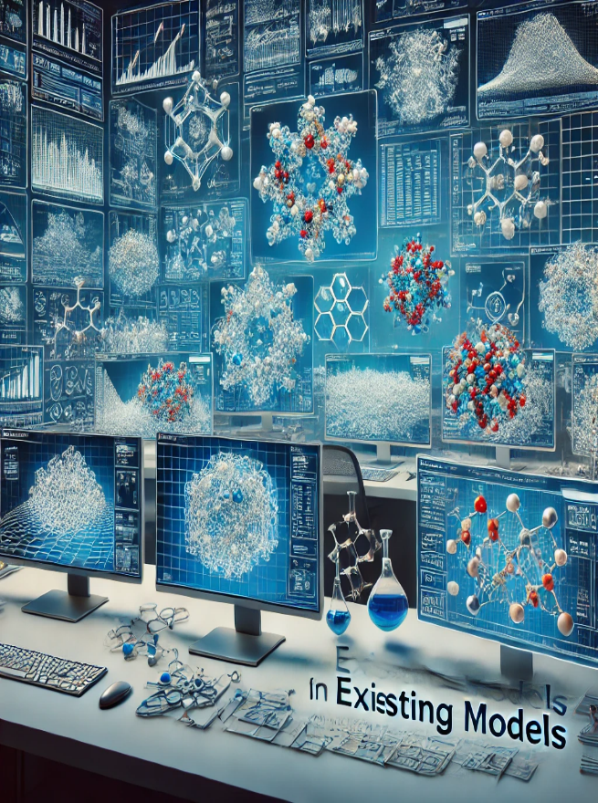
Existing Models in Reaction Simulation
Traditional simulation methods used in computational chemistry:
Density Functional Theory (DFT): Calculates electronic structures of molecules but is computationally expensive.
Molecular Dynamics (MD): Simulates molecular motion but lacks accuracy for complex chemical reactions.
Quantum Mechanics/Molecular Mechanics (QM/MM): Hybrid approach combining quantum and classical methods but requires high computational power.

Slide 6
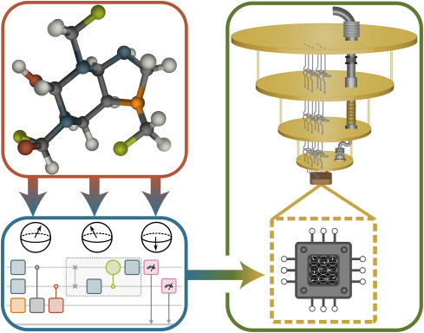
Challenges with Existing Models
High Computational Cost:
Quantum chemistry calculations are time-intensive and resource-heavy.
Slow Simulation Speeds:
Large reaction networks take days or weeks to simulate accurately.
Manual Translation of Reactions into Code:
Chemists must manually input reaction data, leading to errors.

Slide 7
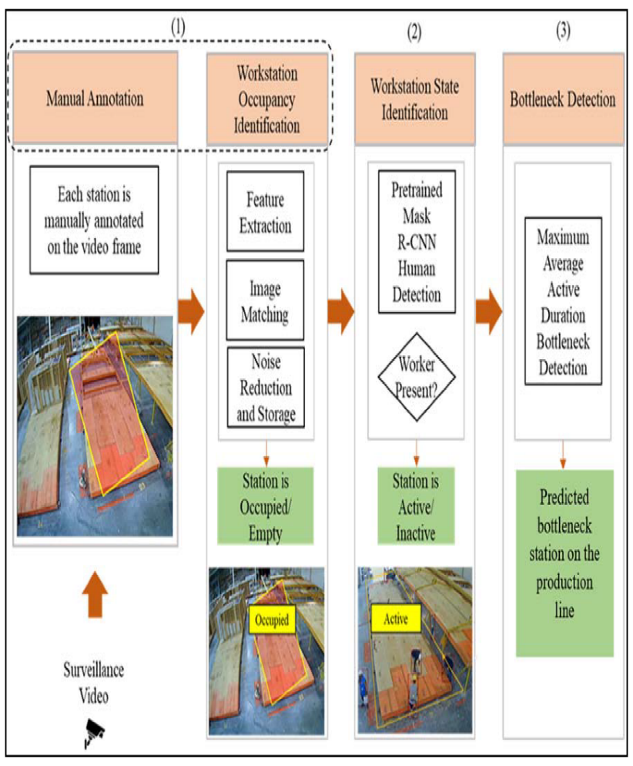
Flaws in Existing Models – Computational Bottleneck
1
Quantum chemistry calculations are computationally expensive.
High time complexity: Simulating large reaction networks is impractical.
Need for high-performance computing resources
2
3

Slide 8
Accuracy Limitations
DFT and Molecular Dynamics use approximations that introduce errors.
Approximation issues:
DFT: Struggles with dispersion forces and electron correlation.
MD: Cannot accurately simulate quantum effects in chemical reactions.
Consequences:
Incorrect predictions of reaction rates and molecular stability.
Poor reproducibility across different simulations.

Slide 9
Introduction to the Proposed Model – Compiler-Based Simulation
Solution:
A specialized compiler that automates reaction translation into optimized simulation code.
Key Features of the Compiler:
Converts chemical equations into machine-readable code.
Optimizes reaction simulations for speed and accuracy.
Generates parallelized code for efficient execution on GPUs and HPC clusters.

Slide 10

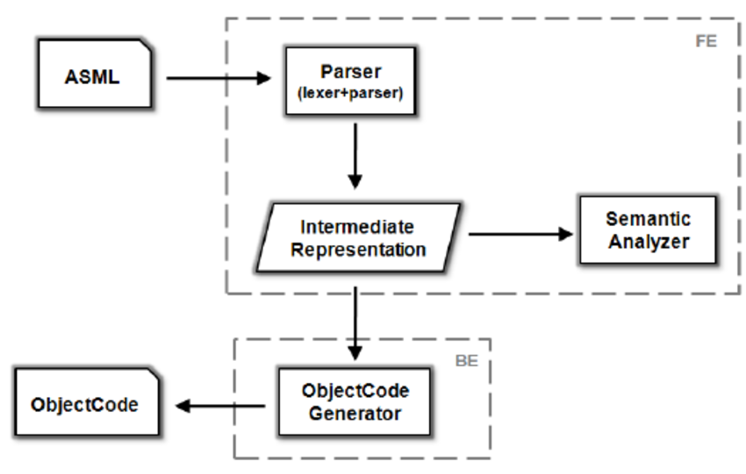



Architecture of the Reaction Compiler
Input:
Chemical reactions, rate constants, environmental conditions.
Intermediate Representation (IR):
Graph-based representation of reaction pathways.
Optimization:
Parallelization, vectorization, memory management.
Code Generation:
Converts into C++, CUDA, OpenCL for efficient execution.

Slide 11



Optimization Techniques in the Compiler
Parallel Computing:
Distributes computations across multiple processors.
Vectorization:
Uses SIMD (Single Instruction, Multiple Data) to enhance computational speed.
Adaptive Time-Stepping:
Adjusts simulation resolution based on reaction dynamics.

Slide 12
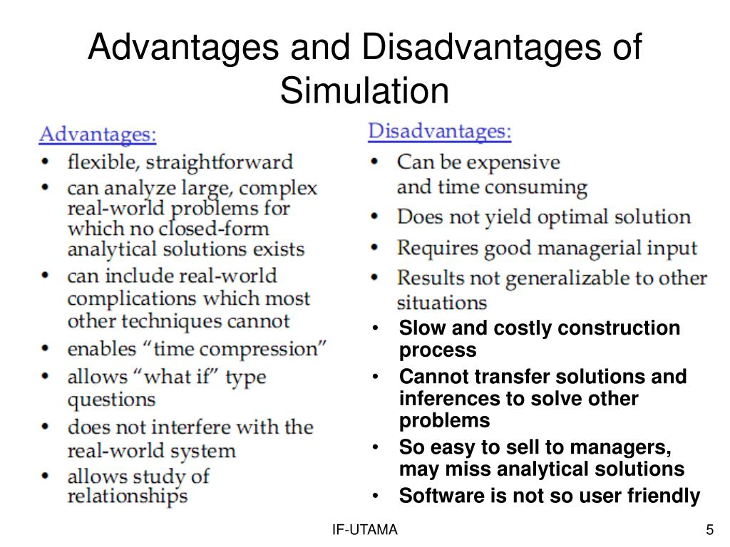
Advantages of Using the Reaction Compiler
Eliminates manual translation of chemical reactions into code.
Achieves up to 10x speedup compared to traditional molecular dynamics packages.
Maintains accuracy with less than 5% error in reaction rate predictions. Scalability:Can simulate reaction networks with over 1000 species.

Slide 13
Implementation – Code Generation Process
Step 1:Input chemical equations and parameters.
Step 2:Convert reactions into an intermediate representation (graph format).
Step 3:Apply optimization techniques (parallelization, vectorization).
Step 4:Generate machine-optimized code in C++/CUDA/OpenCL.
Step 5: Execute simulation and analyze results.

Slide 14
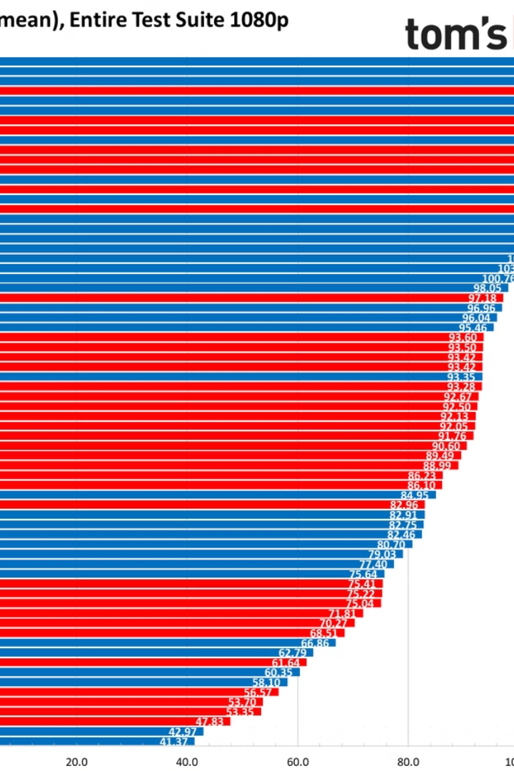
Performance Benchmarks – Speed Improvement
10x faster than traditional simulation methods like LAMMPS.
Efficient handling of complex reaction networks.
Better utilization of modern computing resources (GPUs, HPC clusters).

Slide 15
Performance Benchmarks – Accuracy Validation
Less than 5% deviation in reaction rate predictions compared to experimental data.
Validated across multiple chemical reaction case studies.
Improved reproducibility and precision in simulations.

Slide 16
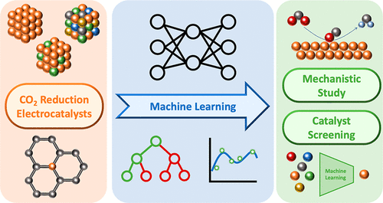
Future Enhancements – Machine Learning Integration
Using AI/ML to predict reaction rates and optimize simulations dynamically.
Self-learning compiler* that improves over time.
Reduces computational cost while maintaining accuracy.

Slide 17
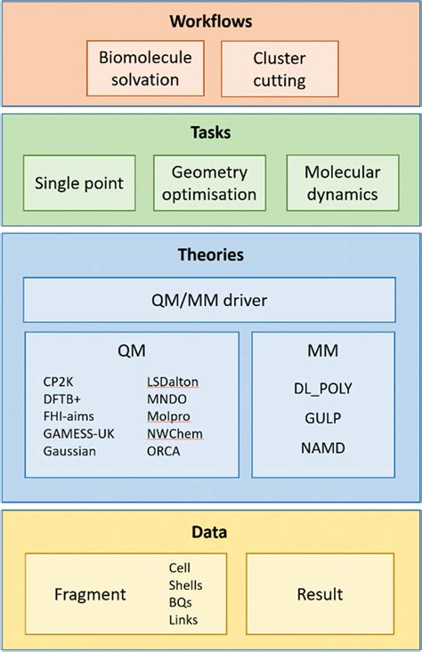
Future Enhancements – Support for QM/MM Models
Hybrid quantum mechanics/molecular mechanics (QM/MM) support.
More accurate modeling of catalytic reactions and protein-ligand interactions.

Slide 18
Future Enhancements –
User-Friendly Interface
Developing a graphical user interface (GUI) to make the compiler accessible to chemists without coding experience.
Simplifying reaction input and result visualization.
Bringing compiler-based chemistry simulations to non-experts

Slide 19

Applications of the Compiler in Industry
Pharmaceuticals:
Drug discovery and molecular interaction modeling.
Energy sector:
Optimization of fuel cells and battery materials.
Environmental science:
Predicting air pollution and climate effects.

Slide 20
Conclusion & Queries
Key Takeaways:
The Reaction Compiler automates and optimizes chemical reaction simulations.
Achieves higher speed, accuracy, and scalability than traditional methods.
Future enhancements include AI integration and GUI development

Slide 21


